Slide 1
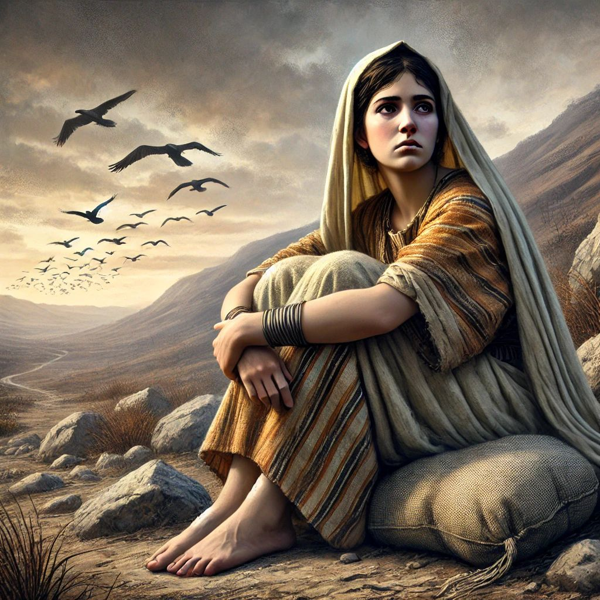
CALLED TO BE FAITHFUL: THE EXAMPLE OF RIZPAH!
2 SAMUEL 21: 1 – 14

Slide 2
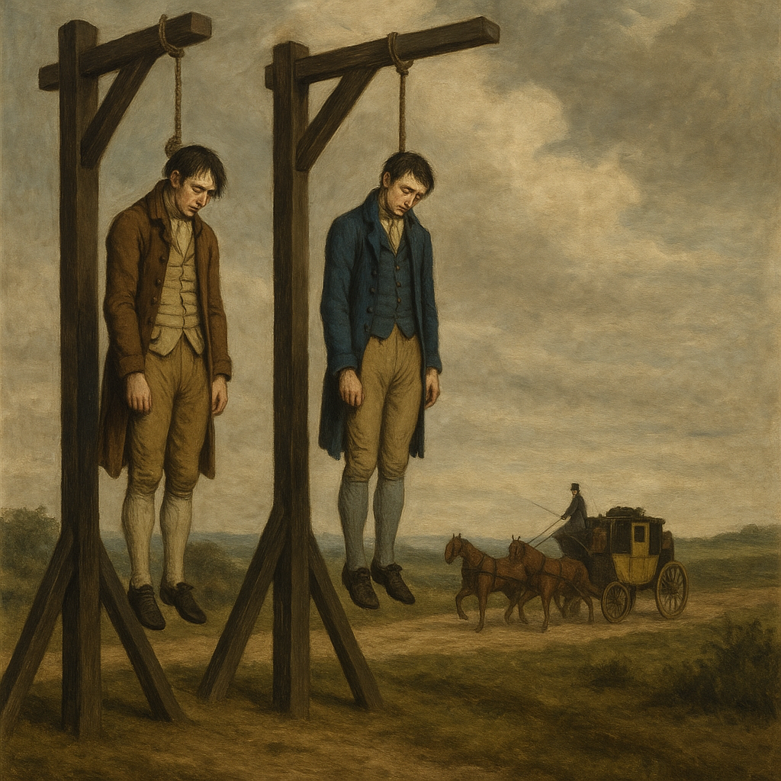
Introduction
In the time of George IV., two men were convicted of robbing the Brighton mail-coach and were hanged on gibbets on the spot where the crime had been committed.
Notes:
When the clothes and the flesh had at length fallen away, an aged woman was observed to go night after night, in all weather, to the lonely spot, and bring away something in her apron. These were the bones of her son, which she interred with her own hands in the parish churchyard.

Slide 3

According to the Bible, God sometimes punishes children because of their father’s sin(s).
In several incidents, God’s punishment included the sinner’s children.

Slide 4
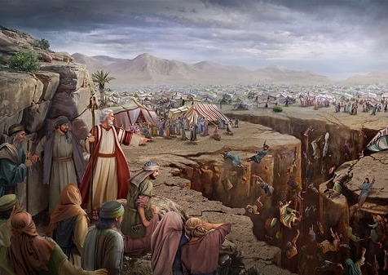
For example, the earth swallowed up the children of Dathan and Abiram when God judged their rebellious parents (Num 16:27, 32).

Slide 5
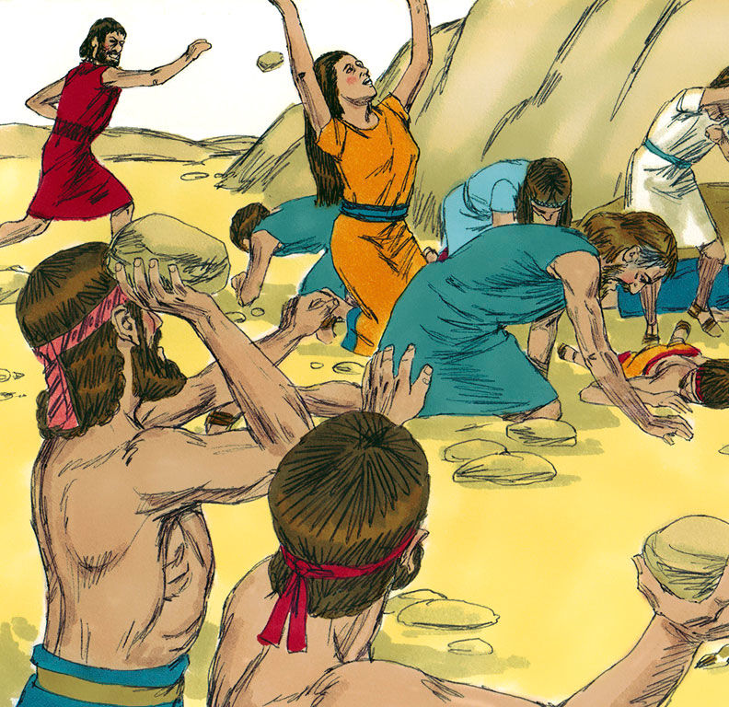
Achan’s children were executed along with their disobedient father (Josh 7:24).

Slide 6
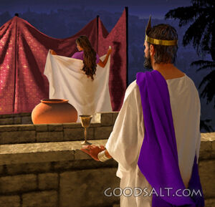
In accordance with David’s self-imposed punishment, the Lord took the lives of four of his children because of his sin against Uriah
(2 Sam 12:5–6, 10; 12:14–15; 13:28–29; 18:15; 1 Kgs 2:25).

Slide 7
Historical Background to the story
(2 Sam. 21:1).
Notes:
“Now there was a famine in the days of David for three years, year after year; and David inquired of the Lord. The Lord said, “There is blood guilt on Saul and on his house, because he put the Gibeonites to death”

Slide 8
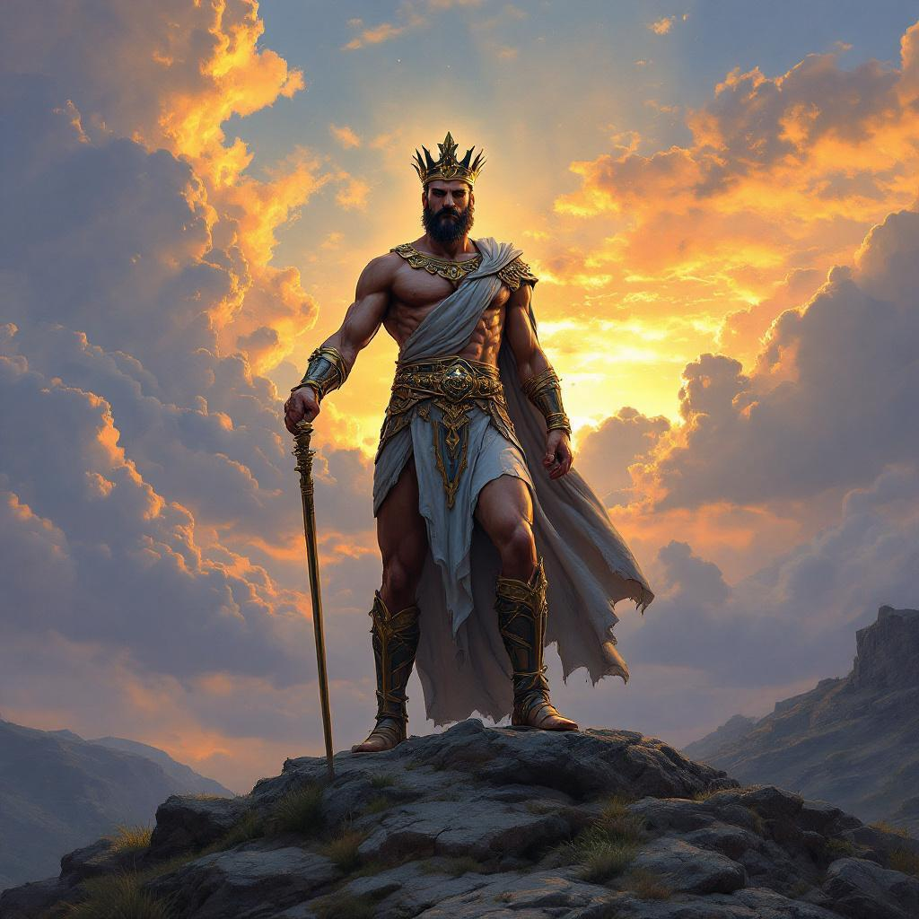
The background for the slaying of Saul’s descendants was this: years before, King Saul had tried to eradicate the Gibeonites from Israel; however, his action violated the covenant Joshua had made with Gibeon in Joshua 9

Slide 9
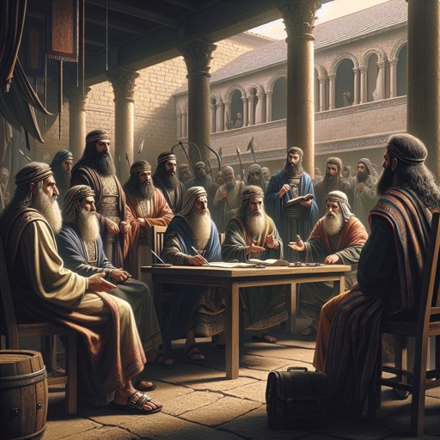
When he asked them what they would require making things right, the Gibeonites requested the lives of seven of Saul’s sons.

Slide 10
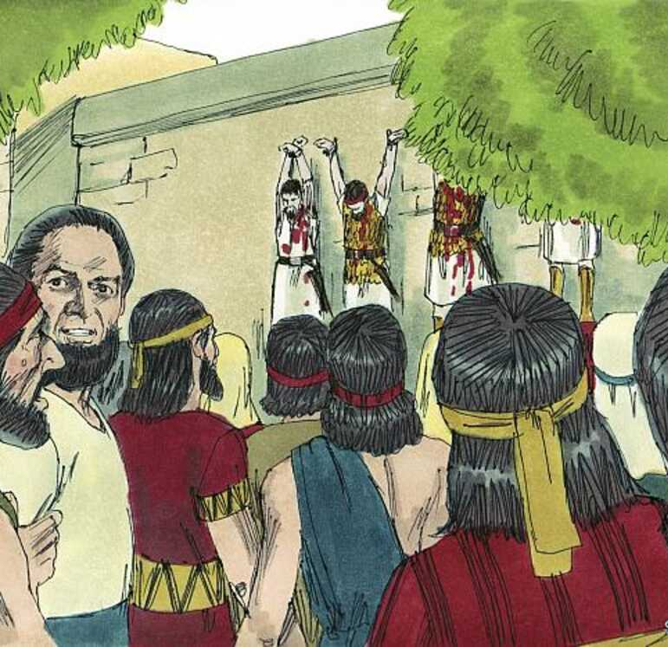
With the Lord’s approval, David turned seven of Saul’s descendants over to the Gibeonites for execution because of Saul’s sins against that city
(2 Sam. 21:1–9).

Slide 11
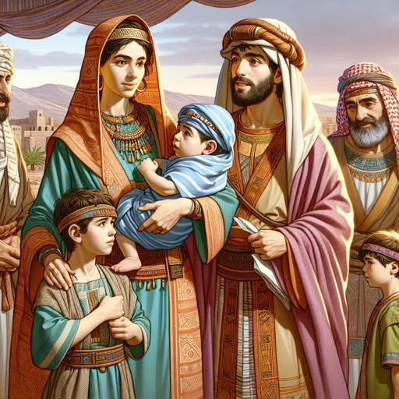
Rizpah’s Sons: Victims of Retributive Justice (2 Sam. 8-10)

Slide 12
Rudyard Kipling's "Mother o' Mine" is a heartfelt tribute to a mother's unconditional love and sacrifice:
Mother o’ mine, O mother o’ mine!
If I were hanged on the highest hill,
Mother o’ mine, O mother o’ mine!
I know whose love would follow me still,
Mother o’ mine, O mother o’ mine!
If I were drowned in the deepest sea,
Mother o’ mine, O mother o’ mine!
I know whose tears would come down to me,
Mother o’ mine, O mother o’ mine!

Slide 13
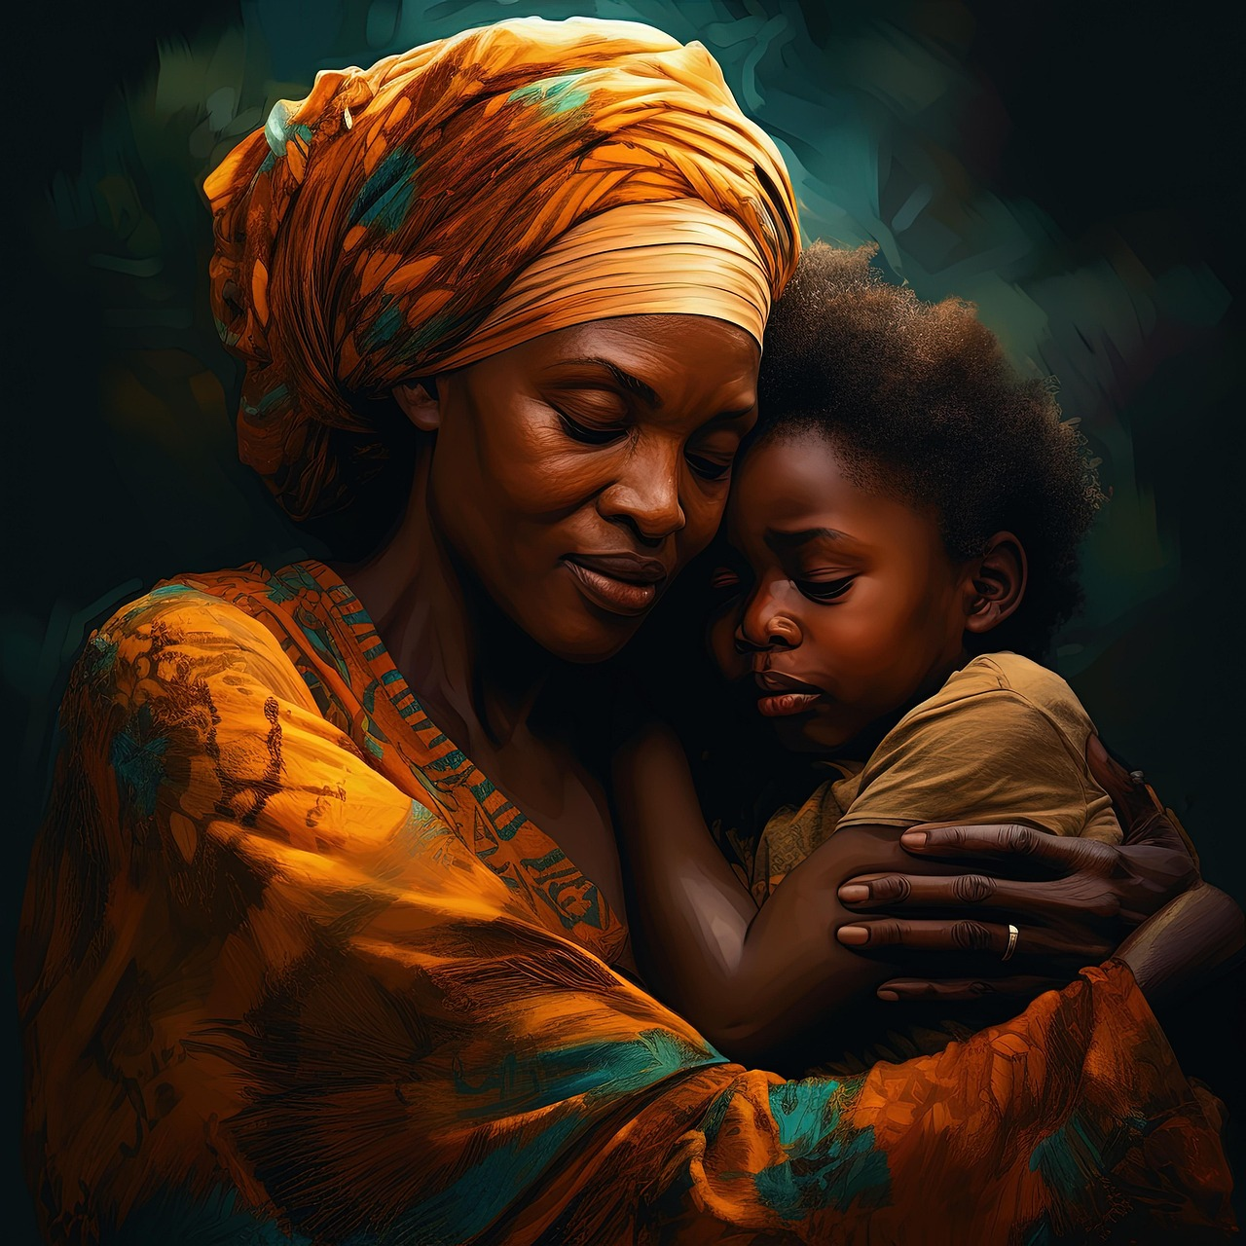
A mother provides unconditional love for her children, and Kipling’s ‘Mother o’ Mine’ poem above, pays tribute to this fact.

Slide 14

If Kipling were hanged for some crime or misdemeanour, his mother would still love him; if he suffered some tragic misfortune such as being drowned, his mother would mourn him; and if he committed a sin so terrible that he was damned in body and soul, he knows that his mother would pray for his salvation.

Slide 15
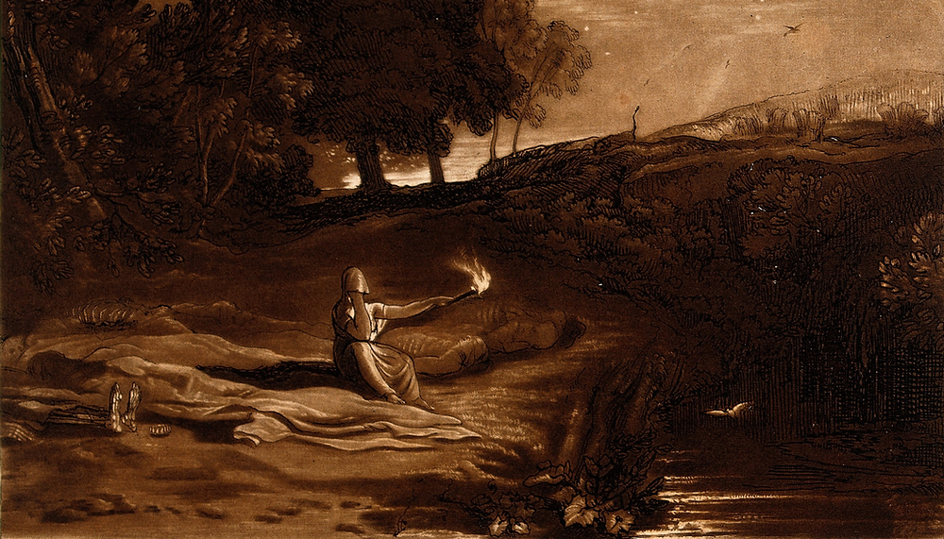
The Duration of Rizpah’s Virgil

Slide 16
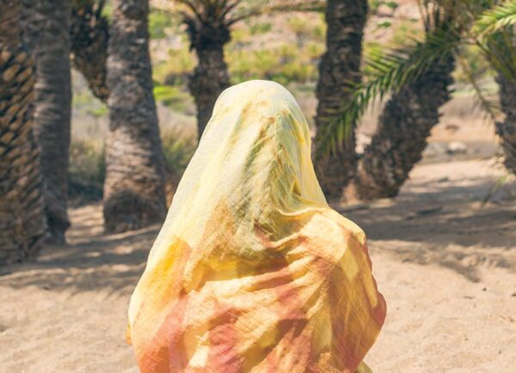
Rizpah, the poor mother and widow watched, therefore, in sackcloth, upon the hard rock from “until water dropped upon them out of Heaven".
Notes:
Bible commentators such as MacArthur and others seem unanimous by placing the period of Rizpah’s Virgil around March/April to October (5 – 7 months). Indeed, the love of a mother for her children is a powerful force.

Slide 17
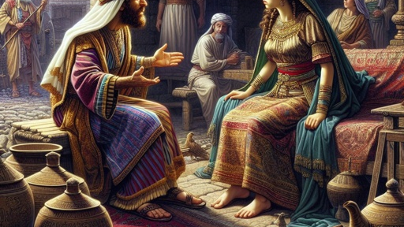
The Effect of Rizpah’s Advocacy on King David (2 Sam. 21: 11 – 14)

Slide 18
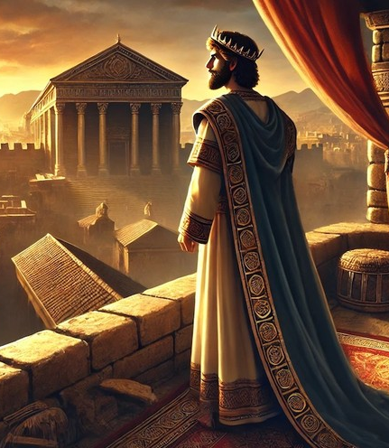
News soon reached King David about Rizpah’s advocacy over her executed family members. David beholds in Rizpah's conduct a lesson to himself, and he proceeds at once to copy the example of piety which that sorrowful bereaved mother has set him.

Slide 19
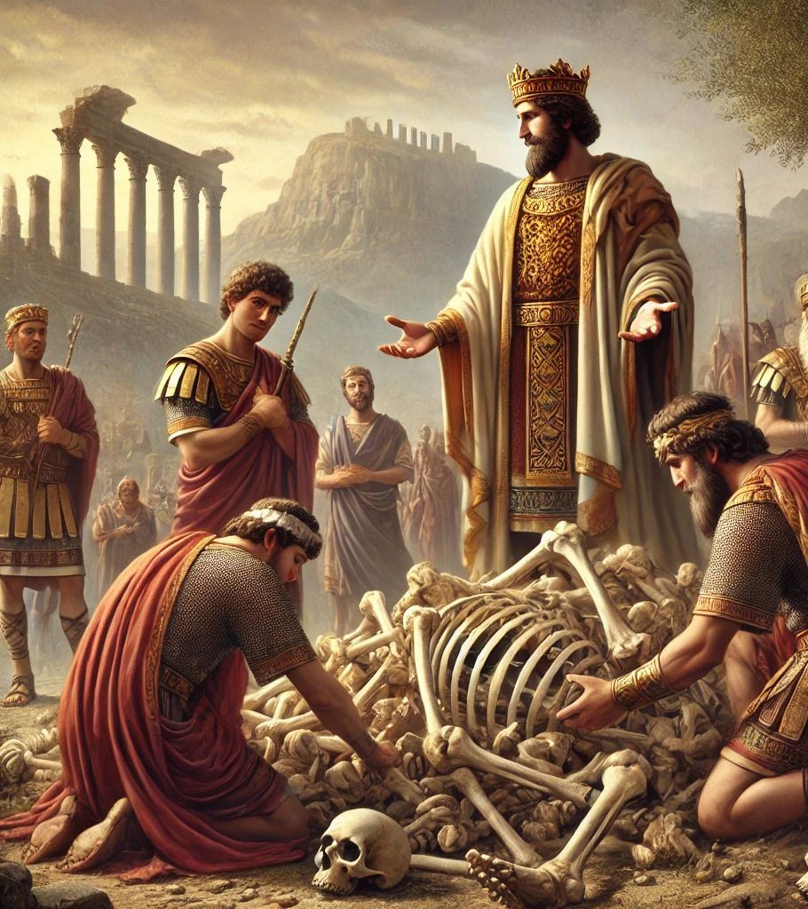
David retrieves the bones of Saul and of Jonathan his son which are still lying dishonoured at Jabesh-Gilead; sends for them; causes the bones of the seven sons who had been hanged at Gibeah to be gathered also; and honourably buries them.
Notes:
So true is it that no one lives to himself; but the effect of good example spreads, a weak woman's example becomes a model for the imitation of the monarch on the throne. We never know, we cannot possibly tell the immediate and or remote consequences of our acts for good or for evil.

Slide 20

Key Lessons For Parents And Children Ministries Coordinators

Slide 21

Lessons for Parents:
Unconditional Love
Advocacy & Justice
Memorials for Victims of Police Brutality
Resilience in Loss:
Faithfulness in Adversity
Notes:
Unconditional Love: Rizpah’s dedication to her sons, even in death, exemplifies the depth of parental love. Parents are called to nurture and protect their children, reflecting God’s love for humanity. The story informs us that if a mother could watch over the decomposing bodies of her sons in this manner, by implication, it revealed a mother who did not in anyway reneged on her duties to her children while they were alive.
Advocacy & Justice: Rizpah’s persistence led to justice and dignity for her sons. Parents should advocate for their children’s well-being, ensuring they grow in a safe and supportive environment.
Memorials for Victims of Police Brutality: Movements like Black Lives Matter have highlighted the importance of honouring victims and advocating for systemic change, much like Rizpah's actions inspired King David to act.
Resilience in Loss: The BringBackOurGirls Movement in Nigeria campaign, led by activists and families, sought the return of schoolgirls abducted by Boko Haram. Like Rizpah, these families demonstrated unwavering commitment to their loved ones' dignity and safety.
Faithfulness in Adversity: Rizpah’s story teaches resilience and faithfulness, encouraging parents to remain steadfast in their responsibilities, even during challenges.

Slide 22
Lessons for Children Ministries Coordinators:
Empathy and Compassion
Role Modelling
Advocacy for Justice
Notes:
Empathy and Compassion: Rizpah's grief reminds teachers to approach children with understanding and care, especially those facing difficulties.
Role Modelling: Her unwavering as a model for teachers to demonstrate dedication and integrity in their ministry.
Advocacy for Justice: Teachers are called to stand up for the rights and dignity of every child, fostering an environment of respect and fairness.

Slide 23
Conclusion
Rizpah's pain and grief can only be imagined as she watches over the seven bodies of the executed.
She builds a makeshift hut from sackcloth and camps close to the decomposing bodies, protecting them from desecration by birds and animals that normally prey on carcasses.
Rizpah appears to watch over the bodies for months, until the autumn rains began to fall on the land.
Notes:
The story further demonstrates that not only was Rizpah a devoted mother, but she also stands out as an example of faithfulness in a story dominated by unfaithful men.

